Slide 1


Scraping Alpha⍺
Stock prediction through sentiment analysis techniques
AARSH SACHDEVA
Scraping Alpha⍺

Slide 2
Table of Contents
Seeking Alpha Overview
Sentiment Analysis
Naïve Bayes Theorem
Implementation Process
Evaluation Metrics
Training Set Sensitivity Analysis
Test Set Results
Next Steps
Scraping Alpha⍺

Slide 3
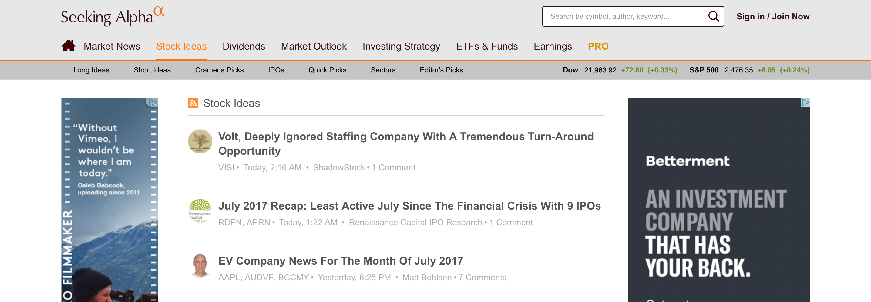
Seeking Alpha
Seeking Alpha is crowd-sourced content service website for financial markets. Published articles and research provide financial commentary and analysis on a wide-variety of topics in the world of finance, such as publicly traded equities, credit, ETFs, investment strategies, company news, and current events.
I chose to scrape stock idea articles
Scraping Alpha⍺

Slide 4
Sentiment Analysis
Scraping Alpha⍺

Slide 5
Sentiment Classification
Typical sentiment analysis attempts to predict the writer’s orientation towards an object by analyzing the words they use to describe it.
For example:
Positive Sentiment: “…zany characters and richly applied satire, and some great plot twists”
Negative Sentiment: “It was pathetic. The worst part about it was the boxing scenes…”
The goal of this analysis is to assign an article a classification of “high” or ”low” that indicates whether the article is successful at predicting positive returns.
Scraping Alpha⍺

Slide 6
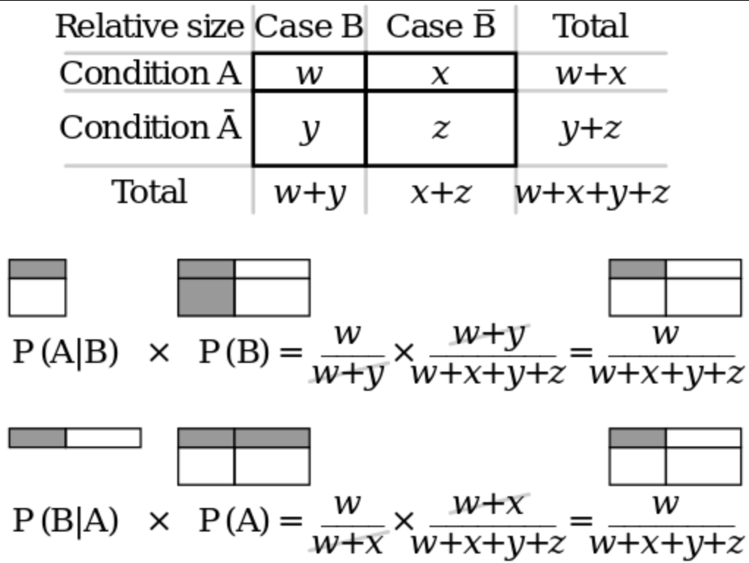

Bayes Theorem
Bayes Theorem is based upon the laws of conditional probability
$$P\left(A\right|B)P\left(B\right)=P\left(B\right|A)P(A)$$
Scraping Alpha⍺

Slide 7
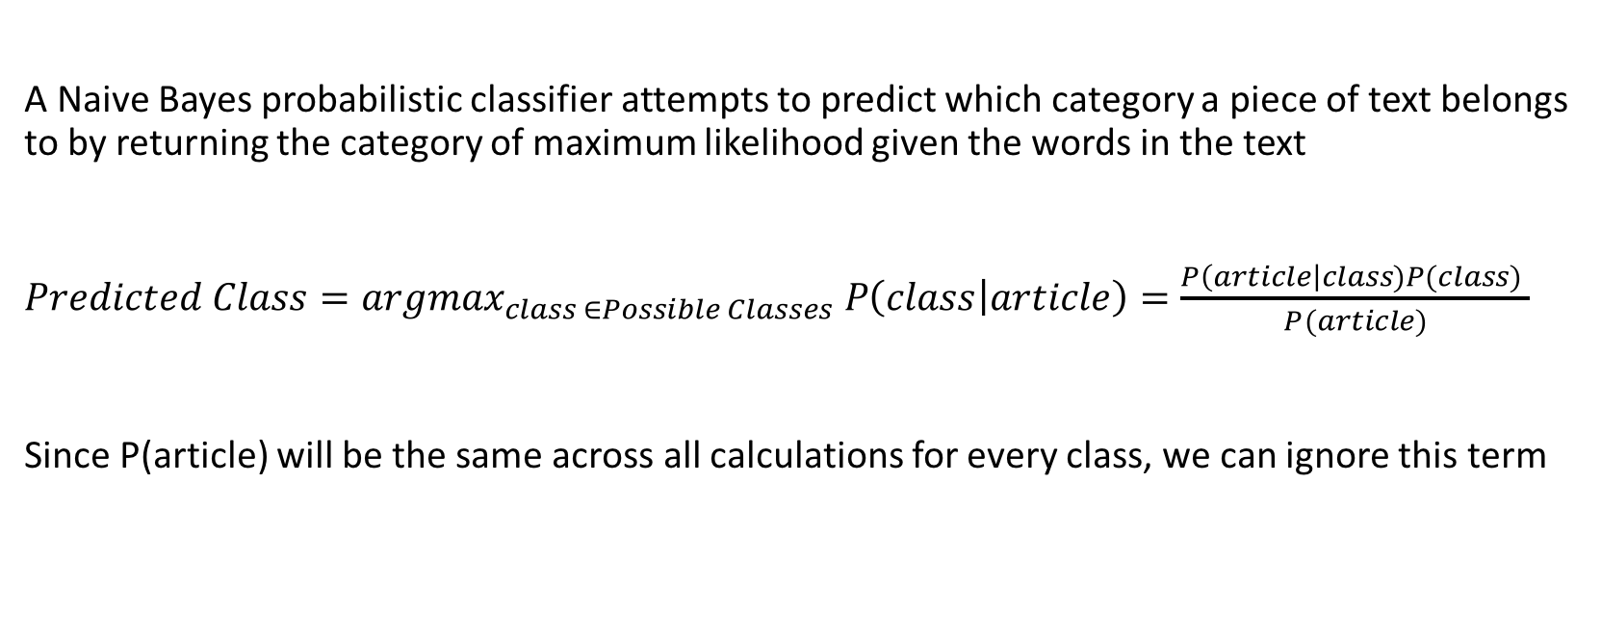
Naïve Bayes Theorem
A Naive Bayes probabilistic classifier attempts to predict which category a piece of text belongs to by returning the category of maximum likelihood given the words in the text
$Predicted Class={argmax}_{class ∈Possible Classes} P\left(class | article\right)=\frac{P\left(article\right|class)P(class) }{P(article)}$
Since P(article) will be the same across all calculations for every class, we can ignore this term
Scraping Alpha⍺

Slide 8
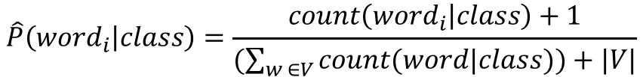
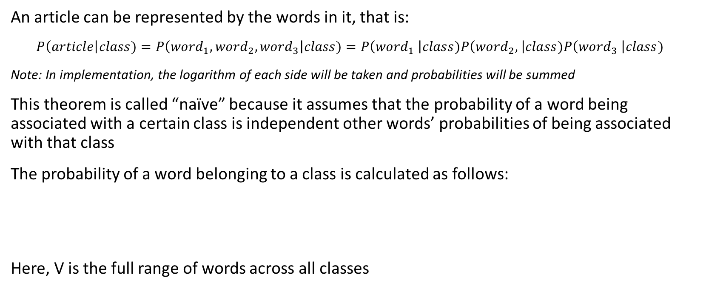
Naïve Bayes Theorem
An article can be represented by the words in it, that is:
$P\left(article\right|class)=P\left({word}_{1},{word}_{2},{word}_{3}\right|class)=P\left({word}_{1} \right|class)P\left({word}_{2}, \right|class)P\left({word}_{3} \right|class)$
Note: In implementation, the logarithm of each side will be taken and probabilities will be summed
This theorem is called “naïve” because it assumes that the probability of a word being associated with a certain class is independent other words’ probabilities of being associated with that class
The probability of a word belonging to a class is calculated as follows:
Here, V is the full range of words across all classes
$$\hat{P}\left({word}_{i} | class\right)=\frac{count\left({word}_{i} | class\right)+1}{(\sum_{w ∈V}{count(word|class))+|V|}}$$
Scraping Alpha⍺

Slide 9
Binary Naïve Bayes Theorem: Example
The following sentences constitute our training data and have already been classified:
Negative: “it was pathetic the worst part was the boxing scenes”
Negative: “no plot twists or great scenes”
Positive: “and satire and great plot twists”
Positive: ”great scenes and great film”
Binary Naïve Bayes Theorem will first reduce each sentence to remove duplicates within each sentence:
Negative: “it was pathetic the worst part boxing scenes”
Negative: “no plot twists or great scenes”
Positive: “and satire great plot twists”
Positive: ”great scenes film”
This training data will then be used to classify the following test sentence:
“great plot with awesome boxing scenes”
Scraping Alpha⍺

Slide 10
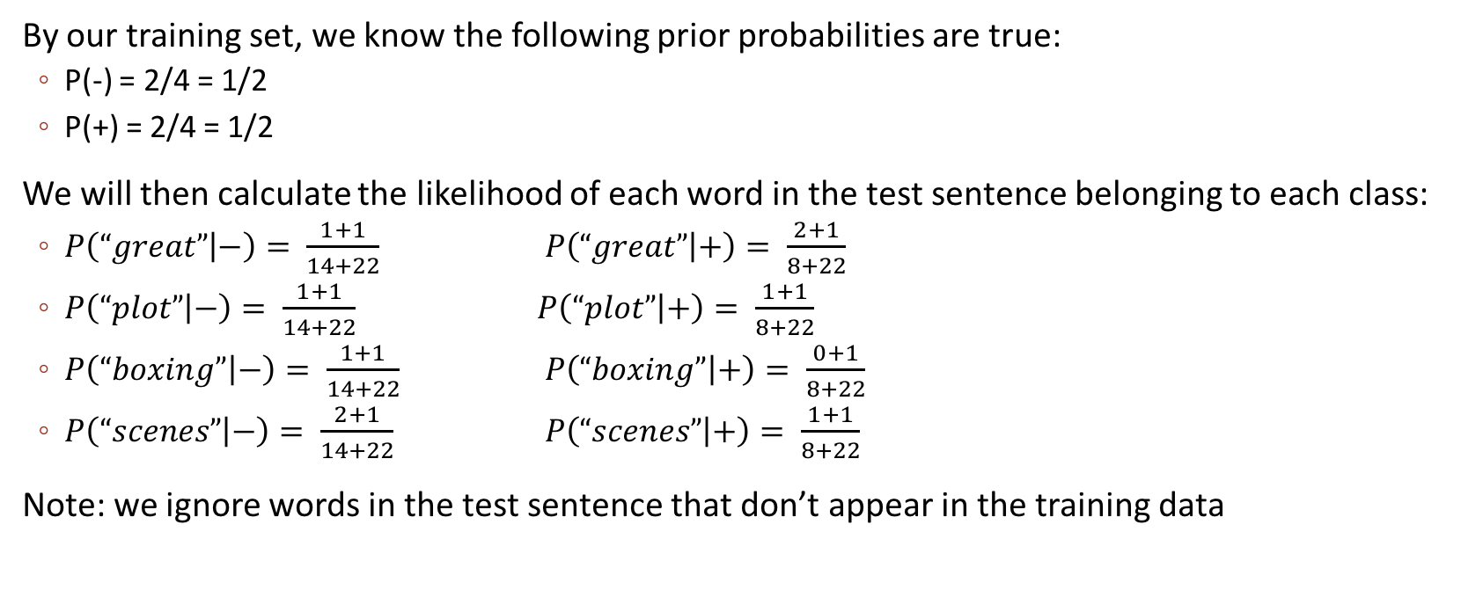
Binary Naïve Bayes Theorem: Example
By our training set, we know the following prior probabilities are true:
P(-) = 2/4 = 1/2
P(+) = 2/4 = 1/2
We will then calculate the likelihood of each word in the test sentence belonging to each class:
$P\left(“great” | −\right)= \frac{1+1}{14+22}$ $P\left(“great” | +\right)= \frac{2+1}{8+22}$
$P\left(“plot” | −\right)= \frac{1+1}{14+22}$ $P\left(“plot” | +\right)= \frac{1+1}{8+22}$
$P\left(“boxing” | −\right)= \frac{1+1}{14+22}$ $P\left(“boxing” | +\right)= \frac{0+1}{8+22}$
$P\left(“scenes” | −\right)= \frac{2+1}{14+22}$ $P\left(“scenes” | +\right)= \frac{1+1}{8+22}$
Note: we ignore words in the test sentence that don’t appear in the training data
Scraping Alpha⍺

Slide 11
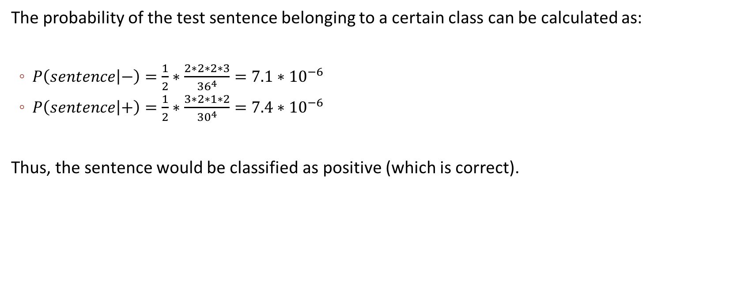
Binary Naïve Bayes Theorem: Example
The probability of the test sentence belonging to a certain class can be calculated as:
$P\left(sentence | −\right)=\frac{1}{2}∗\frac{2∗2∗2∗3}{{36}^{4}}=7.1∗{10}^{−6}$
$P\left(sentence | +\right)=\frac{1}{2}∗\frac{3∗2∗1∗2}{{30}^{4}}=7.4∗{10}^{−6}$
Thus, the sentence would be classified as positive (which is correct).
Scraping Alpha⍺

Slide 12
Implementation
Scraping Alpha⍺

Slide 13
Implementation Process
Scrape Seeking Alpha for long/short idea articles
Chunk off a specific time frame of articles for the training set and a specific frame for the test set. In this analysis, a three year period between 08/2012 and 08/2015 was used for training and a two year period between 08/2015 and 08/2017 was used for testing
Sample a certain number of articles within each time frame. In this analysis, 500 articles were used in training and 200 were used in testing.
In the training set, calculate returns of the associated stocks for a specified holding period. Then assign a cutoff return that will be used to categorize the article as either “high” or ”low”
Optimize the holding period and cutoff point within the training set to achieve best predictive performance
Use these parameters in the model to predict the category an article will fall into in the test set. Then calculate actual realized returns and compare the results
Scraping Alpha⍺

Slide 14
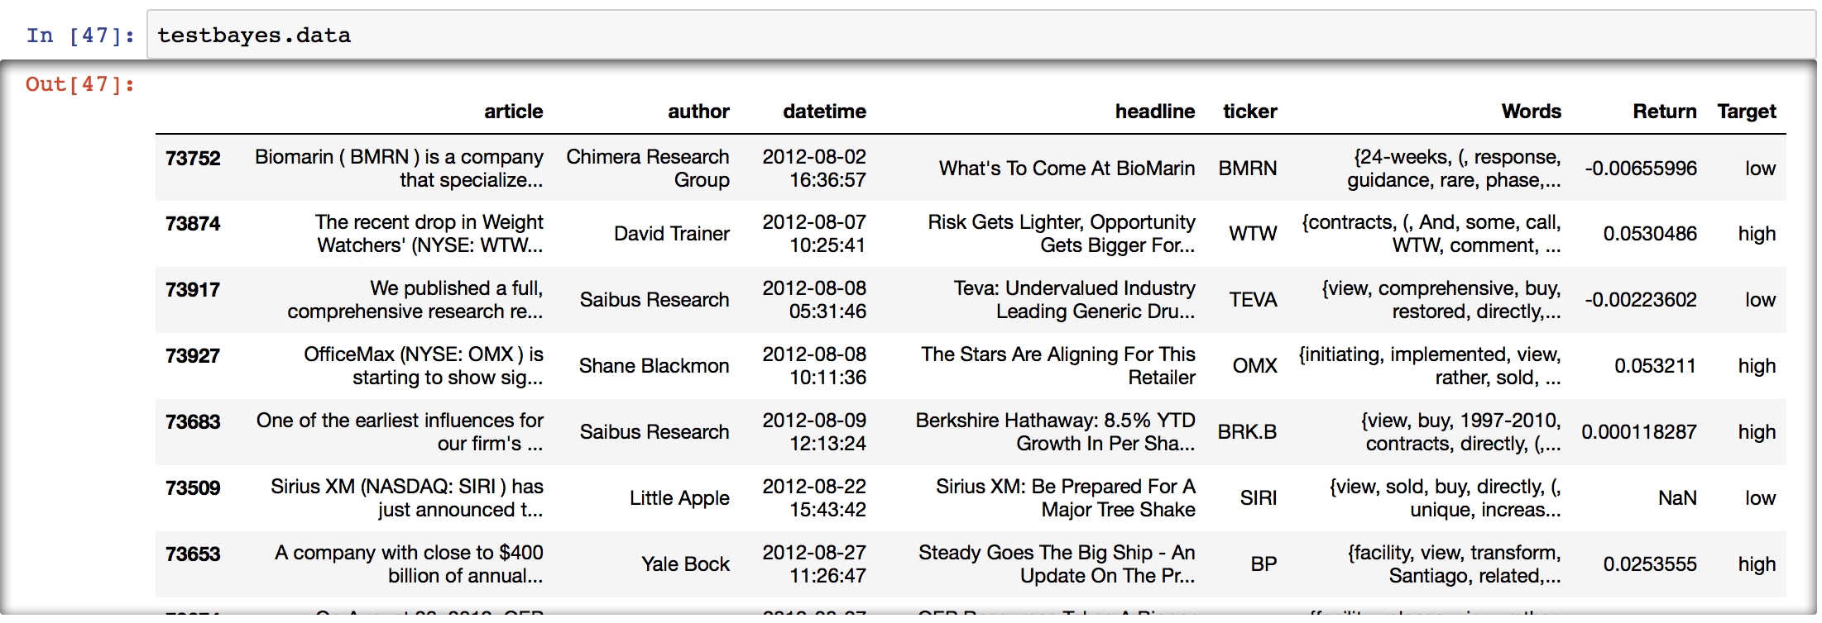
Training Set: A Snapshot
Scraping Alpha⍺

Slide 15
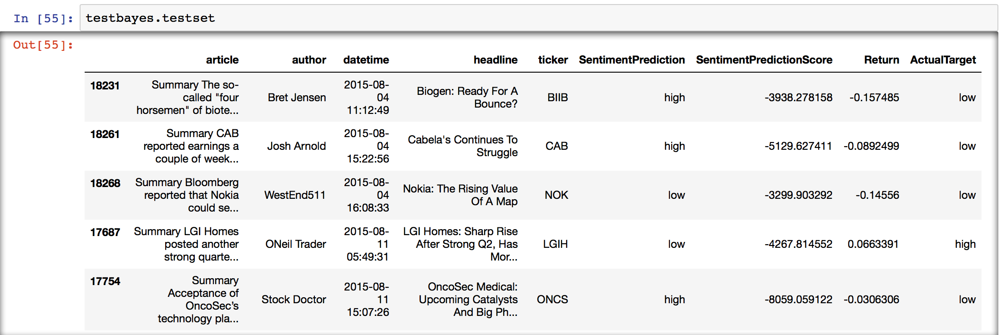
Test Set: A Snapshot
Scraping Alpha⍺

Slide 16
Evaluation Metrics
Scraping Alpha⍺

Slide 17
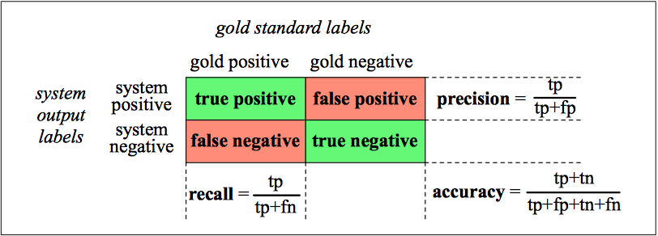
Evaluation: Precision, Recall, F-Measure
$F_{1}−Measure: \frac{2∗Precision∗Recall}{Precision+Recall}$
Scraping Alpha⍺

Slide 18
Training Set Sensitivity Analysis (100-Article Sample)
Cutoff Return
F₁-Measure | 0% | 3% | 5%
10-Day | 1.0 | 1.0 | 1.0
20-Day | 1.0 | 1.0 | 1.0
60-Day | 1.0 | 1.0 | 1.0
Accuracy | 0% | 3% | 5%
10-Day | 1.0 | 1.0 | 1.0
20-Day | 1.0 | 1.0 | 1.0
60-Day | 1.0 | 1.0 | 1.0
Holding Period
Precision | 0% | 3% | 5%
10-Day | 1.0 | 1.0 | 1.0
20-Day | 1.0 | 1.0 | 1.0
60-Day | 1.0 | 1.0 | 1.0
Recall | 0% | 3% | 5%
10-Day | 1.0 | 1.0 | 1.0
20-Day | 1.0 | 1.0 | 1.0
60-Day | 1.0 | 1.0 | 1.0
Scraping Alpha⍺

Slide 19
Test Set Performance (10-Day Holding Period, 0% Cutoff)
Precision | Recall | Accuracy | F1-Measure
0.425 | 0.765 | 0.460 | 0.546
Expected 20-Day Return from Long Positions: -0.829%
Expected 20-Day Return from Short Positions: 2.267%
Expected Annual Return from a Long/Short Portfolio: 19.796%
Scraping Alpha⍺

Slide 20
Test Set Performance (20-Day Holding Period, 0% Cutoff)
Precision | Recall | Accuracy | F1-Measure
0.531 | 0.645 | 0.570 | 0.583
Expected 20-Day Return from Long Positions: -0.310%
Expected 20-Day Return from Short Positions: 0.216%
Expected Annual Return from a Long/Short Portfolio: -0.591%
Scraping Alpha⍺

Slide 21
Next Steps
Filter out training and test sets by industry (a lot of money was lost in energy/commodities)
Filter out data sets by market cap (we don’t want to invest in small-cap or OTC)
Calculate a “Trust-Value” score for reliable authors and incorporate it into the decision to invest
Attempt to fit and incorporate other sentiment analysis models (e.g. Decision Trees)
Test out the model across other sources, maybe hop on a Bloomberg and assess professional equity research
Develop a full backtest on Quantopian
Scraping Alpha⍺

